Slide 1


Slide 2

ABA Risk Management Conference
Three Dynamic Forces of Risk Management
Clifford V. Rossi, PhD
Robert H. Smith School of Business, University of Maryland
Chesapeake Risk Advisors, LLC
aba.com 1-800-BANKERS

Slide 3
Three Dynamic Forces at Work in Risk Management
Dynamic Force 1:
  Risk psychology, market dynamics and risk responses
Dynamic Force 2:
  Risk landscape dynamics
Dynamic Force 3:
  Risk skill dynamics
Page 3
Notes:
Emphasize that the business risk assessment includes all “classes” of risks and IT is one of the classes:
Strategic
Financial
Compliance
Operational
Information Technology
Governance
These “classes” are part of the Risk Universe discussed later.

Slide 4
Dynamic Force 1:
  Risk Psychology, Market Dynamics and Risk Responses
Page 4

Slide 5
Risk Psychology, Market Dynamics and Risk Responses
We all take risks to varying degrees – our behavior and biases toward risk-taking greatly impacts the risk environment
That risk environment is also in a state of flux with the business cycle
How we as risk managers respond to these conditions is of enormous consequence to risk outcomes
Page 5
Notes:
Emphasize that the business risk assessment includes all “classes” of risks and IT is one of the classes:
Strategic
Financial
Compliance
Operational
Information Technology
Governance
These “classes” are part of the Risk Universe discussed later.

Slide 6
Risk Psychology at Work – Audience Participation!
Psychology and Behavior of Risk
Thought Experiment 1
While at Vegas you run into someone who offers you this game where you have 2 choices:
  Receive $1,000 on the spot, or
  A 50% chance of receiving $2,000 and a 50% chance of receiving nothing
How many choose the first alternative?
Page 6
14

Slide 7
Risk Psychology at Work – Audience Participation!
Psychology and Behavior of Risk
Thought Experiment 2
Now what choice would you make if you were offered to pick between these 2 alternatives:
  An 80% chance of losing $4,000 and a 20% chance of breaking even, or
  A 100% chance of losing $3,000
How many select the first alternative?
Page 7
15

Slide 8
Risk Psychology at Work
Psychology and Behavior of Risk
Outcomes
In the first experiment both outcomes have the same mathematical expectation,
  .5($2,000)+.5(0) = $1,000
  Most people are risk-averse, preferring the certain gain over a fair gamble
In the second example, the gamble has an expected loss of .8($4,000)+.2(0) = $3,200 or more than the certain loss of $3,000
  We are risk-seekers in this case when it comes to losses by selecting the first outcome, and hope to avoid the certain loss
Page 8
16

Slide 9
Risk Psychology at Work
Psychology and Risky Behavior
“Failure of Invariance” – Kahneman &Tversky
  Prospect Theory and asymmetric decisions can explain differences in our decisions involving gains and losses
Cognitive Bias
  Herd mentality
  “Recency Bias”
  Confirmation Bias
  Ambiguity Bias
Page 9
17

Slide 10
Market Dynamics & Risk Psychology
Behavior is conditioned on environment
As financial markets change, so do customer, management and policymaker attitudes and behaviors
This intersection of risk psychology and market dynamics is critical to effective risk management
Page 10
Notes:
Emphasize that the business risk assessment includes all “classes” of risks and IT is one of the classes:
Strategic
Financial
Compliance
Operational
Information Technology
Governance
These “classes” are part of the Risk Universe discussed later.

Slide 11

Cycles and Behavior – Building Up
Boom period – the calm before the storm
  Favorable market and policy conditions promote greater risk-taking
  Cognitive biases take root
Page 11
Notes:
Emphasize that the business risk assessment includes all “classes” of risks and IT is one of the classes:
Strategic
Financial
Compliance
Operational
Information Technology
Governance
These “classes” are part of the Risk Universe discussed later.

Slide 12

Cycles and Behavior – Blowing Up
Bust period
  Market stress
  Panic and fear
  Reactive response to crisis
    Regulatory
    Market
Page 12
Notes:
Emphasize that the business risk assessment includes all “classes” of risks and IT is one of the classes:
Strategic
Financial
Compliance
Operational
Information Technology
Governance
These “classes” are part of the Risk Universe discussed later.

Slide 13

Cycles and Behavior – Digging Out
Post-crisis period
  Market and regulatory tightening (“Regulatory Dialectic”)
  Reassessment and circumspection
  But can we be letting our guard down?
Page 13
Notes:
Emphasize that the business risk assessment includes all “classes” of risks and IT is one of the classes:
Strategic
Financial
Compliance
Operational
Information Technology
Governance
These “classes” are part of the Risk Universe discussed later.

Slide 14

Cycles and Behavior: Back to the Future?
Signs of a building up phase
  Market signals
    Economic growth projections revised upward
    Inflationary concerns stoked by tax reform and other pro-growth policies
  Deregulation
    Dodd-Frank Act – e.g., enhanced prudential standards
    CFPB
It’s a fair bet that behavior will adapt to market conditions – are you ready?
Page 14
Notes:
Emphasize that the business risk assessment includes all “classes” of risks and IT is one of the classes:
Strategic
Financial
Compliance
Operational
Information Technology
Governance
These “classes” are part of the Risk Universe discussed later.

Slide 15
Risk Responses
Recognize the signs of important shifts in management attitudes and behavior toward markets, products and services
Don’t take a mechanical approach to risk assessment
Take time to understand potential behavioral impacts from new or enhanced products and services
Page 15
Notes:
Emphasize that the business risk assessment includes all “classes” of risks and IT is one of the classes:
Strategic
Financial
Compliance
Operational
Information Technology
Governance
These “classes” are part of the Risk Universe discussed later.

Slide 16
Dynamic Force 2:
  Risk Dynamics
Page 16

Slide 17
Risk Evolution & Revolution
Risk evolution
  Risk taxonomies are changing as well our emphasis on various risks – a move toward nonfinancial risk focus
Risk revolution
  How we approach risk management has also changed over time
    Two dominant tendencies have emerged in risk management over the last decade
      Quantitative assessment
      Process and control
Page 17
Notes:
Emphasize that the business risk assessment includes all “classes” of risks and IT is one of the classes:
Strategic
Financial
Compliance
Operational
Information Technology
Governance
These “classes” are part of the Risk Universe discussed later.

Slide 18
Risk Evolution
Risk ecosystem expansion (systemic risk event of 2008-2009 opened our eyes)
Elevated focus on nonfinancial risks
Credit
Credit
Reputation
Reputation
Market
Operational
Factors Driving Change
Technology
Competition
Market conditions
Strategic
Market/Interest Rate
Operational
Legal
Legal
Strategic
Cyber/Info Security
Liquidity
Cyber/Info Security
Liquidity
Regulatory/Compliance
Regulatory/Compliance
Historically
Page 18
Current State

Slide 19

Risk Revolution
Quantitative focus of risk management
  More actuarial-like
  Things to watch out for:
    Loss of “qualitative muscle mass”
    “Shiny object bias” – overconfidence in empirical models
Process and control dominating environment
  A natural aftermath of the financial crisis – back to basics
  Things to watch out for:
    Avoiding assembly line mentality and the potential to lose situational risk awareness
    Checking the box syndrome ✓
Page 19
Notes:
Emphasize that the business risk assessment includes all “classes” of risks and IT is one of the classes:
Strategic
Financial
Compliance
Operational
Information Technology
Governance
These “classes” are part of the Risk Universe discussed later.

Slide 20
Dynamic Force 3:
  Risk Management Skill Dynamics
Page 20

Slide 21
More Audience Participation
How many of you studied or have a degree in risk management?
How many of you said when you were little – when I grow up I want to be a risk manager?
How many of you believe your way into risk management was somewhat accidental?
Page 21
Notes:
Emphasize that the business risk assessment includes all “classes” of risks and IT is one of the classes:
Strategic
Financial
Compliance
Operational
Information Technology
Governance
These “classes” are part of the Risk Universe discussed later.

Slide 22
Risk Management Skill Dynamics
Ingredients for making a good risk professional vary by position, but these three are essential in some combination:
  Risk and business domain expertise – gets you noticed
  Organizational management – moves you up
  Leadership – keeps you there
Page 22
Notes:
Emphasize that the business risk assessment includes all “classes” of risks and IT is one of the classes:
Strategic
Financial
Compliance
Operational
Information Technology
Governance
These “classes” are part of the Risk Universe discussed later.

Slide 23
Risk & Business Domain Expertise
Experience and judgment over the business cycle
Understanding of asset and liability acquisition processes
  Loan manufacturing lifecycle
  Policies and procedures
  Key drivers of risk
  Risk mitigation strategies
  Processes and controls
Empirical orientation to risk management
  Data driven
  Analytics driven capabilities
Native curiosity and ability to think broadly about risk issues
Page 23
Notes:
Emphasize that the business risk assessment includes all “classes” of risks and IT is one of the classes:
Strategic
Financial
Compliance
Operational
Information Technology
Governance
These “classes” are part of the Risk Universe discussed later.

Slide 24
Organizational Management
Demonstrated ability to conceptualize a risk management problem into an actionable plan
Attention to detail without being mired in a 99.9% solution
Sense of urgency
Team orientation – leave your ego at the door
Effective allocation of resources for the task
Page 24
Notes:
Emphasize that the business risk assessment includes all “classes” of risks and IT is one of the classes:
Strategic
Financial
Compliance
Operational
Information Technology
Governance
These “classes” are part of the Risk Universe discussed later.

Slide 25
Leadership Qualities
Awareness – Risk Intelligence
  To situations
  To individuals and groups (“reading” skills)
Vision – lean forward
Influence – shape the conversation with insight and stature
Inspire – bring others along to your vision
Leverage – be a force multiplier
Communicate – 360 degrees
Balance – are you a watch dog or a lap dog?
Courage – if you see something say something
Page 25
Notes:
Emphasize that the business risk assessment includes all “classes” of risks and IT is one of the classes:
Strategic
Financial
Compliance
Operational
Information Technology
Governance
These “classes” are part of the Risk Universe discussed later.

Slide 26
Risk Practitioner Competency Composition
Page 26

Slide 27
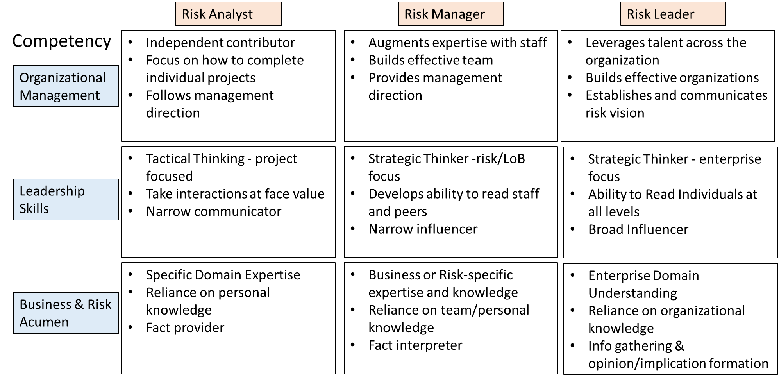
Risk Practitioner Key Competencies
Page 27

Slide 28
Force 3 Takeaways
Manage career “risk” as you would other firm risks
What is your inherent career risk?
  Mapped against current and/or prospective positions you aspire to
    Domain expertise
    Leadership
    Organizational management
Evaluate your personal control environment
  Conduct your own skill inventory
Determine your residual risk
  What skills do I need to work on to bridge a gap
Page 28

Slide 29
Closing Remarks
Recognize the Three Dynamic Forces of Risk Management facing you and your organization today
Keep an eye open for important behaviors, biases and attitudes among customers and management that could affect risk-taking as the cycle turns
Embrace the changing nature of risk and the ongoing trends in managing risk but be aware of potential blind spots along the way
Finally, turn the accidental nature of your career into a proactive personal and professional quest for continuous improvement
Page 29

