Slide 1

Enhancing FDIC’s Risk-based Deposit Insurance Assessment Framework
October 10, 2025
ABA/University of Maryland Banking Workshop
Dr. Clifford Rossi, Director, SERC
Professor of the Practice & Executive in Residence
Robert H. Smith School of Business

Slide 2
Key Themes
Since 1993, the FDIC has continued to refine its risk-based methodology used to assign deposit insurance assessment rates to insured depository institutions
The current framework could be further enhanced along several dimensions to better align deposit insurance assessments for the riskiest institutions based on a set of design principles.
  Principle 1: Integration between the twin theories of bank failure; insolvency risk (weak fundamentals) and run risk would better reflect the drivers of bank failure in assessment rates
  Principle 2: Inherent nonlinearity between bank risk and failure should be captured more directly in the deposit assessment process
  Principle 3: Deposit assessment rates should recognize impacts of extranormal growth on bank risk
  Principle 4: Risk management deficiencies should be more directly captured in the deposit assessment rate process
  Principle 5: Overall capital position and not just leverage ratio should be captured
  Principle 6: Assessment rate methodology should be transparent and relatively easy for banks to implement.
  Principle 7: Assessment rate methodology should strive for consistency across the industry with some variation as required.
  Principle 8: Assessment rates should be based on forward-looking risk factors as much as possible and incorporate key risk drivers.

Slide 3
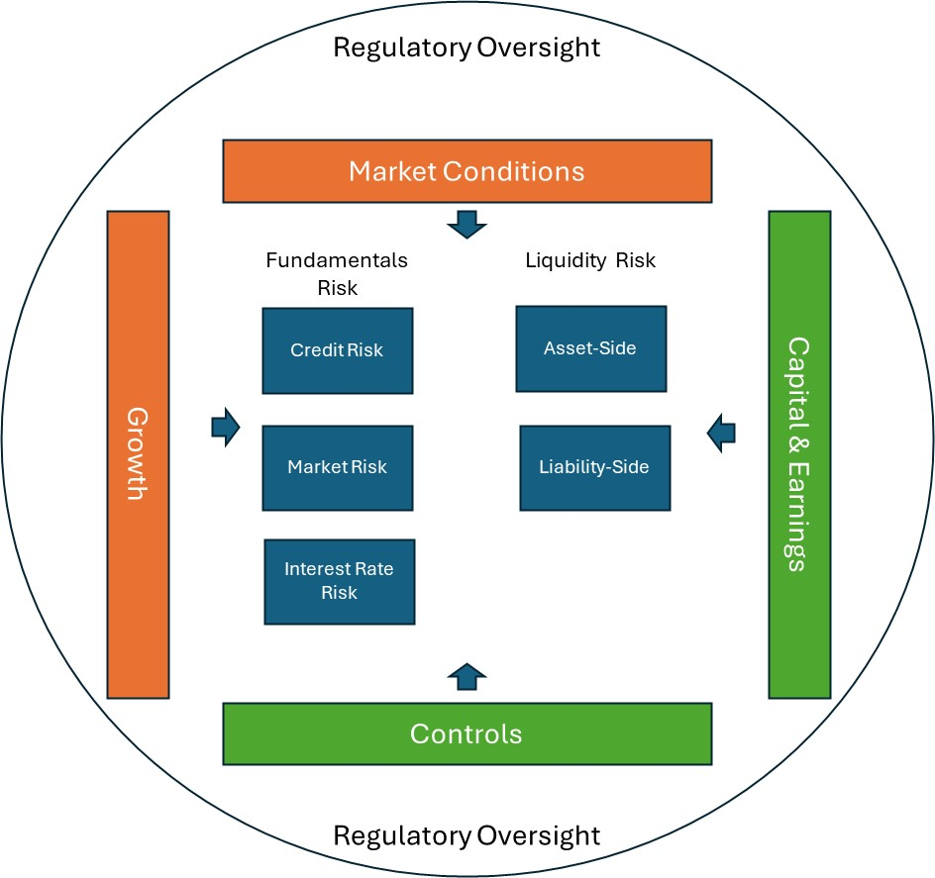
Internal and External Forces Determining Bank Failure
While the drivers of bank failure are multifaceted and have been statistically analyzed for years, including by the FDIC, a more structured representation shown in Figure 1 can inform the design of future deposit risk-based pricing frameworks
Figure 1

Slide 4
Current State of Deposit Assessment Rate Process
The FDIC uses three scorecards featuring various risk factors to determine a bank’s deposit assessment rate;
  Small banks (i.e., <$10 billion in assets),
  Large banks (>=$10 billion in assets)
  Highly complex banks

Slide 5
Current State of Deposit Assessment Rate Process
The scorecards for large and highly complex banks are a bit different from those used by small banks.
The base assessment rate before adjustments is determined as the product of the total performance score and loss severity factor.
Three primary factors are used in determining assessment rates for these banks total performance;
  Composite CAMELS rating (weight of 30%);
  Factors that reflect the bank’s ability to withstand asset-related stress (weight of 50%) and
  Factors reflecting the bank’s ability to withstand funding-related stress (weight of 20%).
Loss severity is determined as the ratio of potential loss to total domestic deposits.
The total performance score is effectively a proxy of the likelihood of a bank’s failure.
Key question: How effective are these scorecards at reflecting the riskiness of banks such as SVB or WaMu well in advance of failure?

Slide 6
Current State of Deposit Assessment Rate Process
Some issues with the current pricing methodology center around
  Degree of complexity and transparency in the pricing methodology, (e.g., reliance on statistical model of bank failure for small bank scorecard),
  Underrepresentation of key risks (e.g., interest rate/market risk, uninsured deposits),
  Overrepresentation of other risk factors, (e.g., CAMELS) and
  Degree of linearity assumed in pricing by risk factor (e.g., impact of specific risk types such as credit)

Slide 7
Potential Future State Considerations: Integrate Theories of Bank Failure into Deposit Assessment Rate Process
Current deposit assessment rate methodology largely reflects the insolvency (weak fundamentals) theory of bank failure.
Risk factors indicative of a bank’s ability to withstand funding related stress appear only in the large and highly complex bank scorecards and underrepresent known run risk factors such as uninsured deposit concentrations
However, academic research such as that conducted by Morris and Shin present a compelling case that the weak fundamentals and bank run models together provide a better explanation for bank failure than either model on its own

Slide 8
Potential Future State Considerations: Integrate Theories of Bank Failure into Deposit Assessment Rate Process
As noted by Correia et al., “Moreover, dynamic interactions between solvency and funding can amplify distress: declining solvency may trigger deposit outflows and rising funding costs, which in turn further weaken solvency.”
This amplification effect was clearly evidenced in the 2023 bank failures and exacerbated by high uninsured deposit concentrations and digital banking and social media effects.
The current deposit assessment framework does not adequately capture this potential amplification effect between run risk, bank fundamentals and failure.

Slide 9
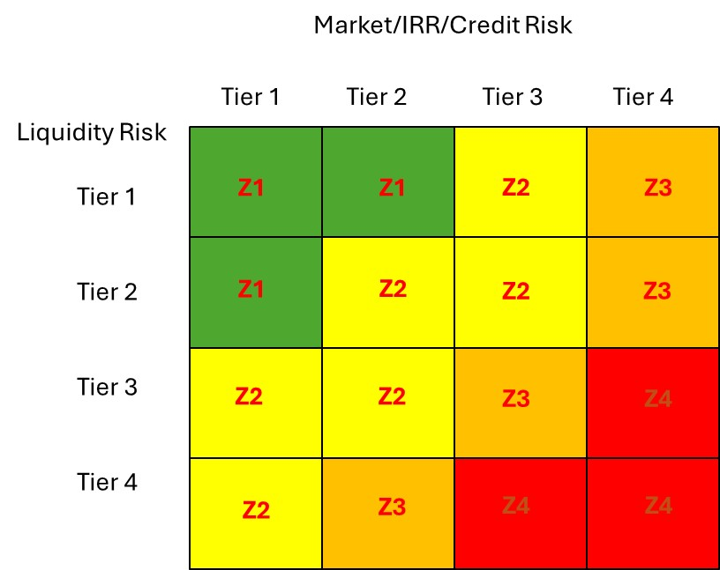
Potential Future State Considerations: Integrate Theories of Bank Failure into Deposit Assessment Rate Process
Enhancement to the current risk-based framework could consider using a methodology for determining the likelihood of failure based on a dual scoring of liquidity risk and bank fundamentals.
This could be implemented in a simplified way using a nxm matrix as illustrated in Figure 2 where base assessment rates Z_{i} would be established based on risk factors representing each major risk type and Z₄ > Z₃ > Z₂ > Z₁
Figure 2

Slide 10
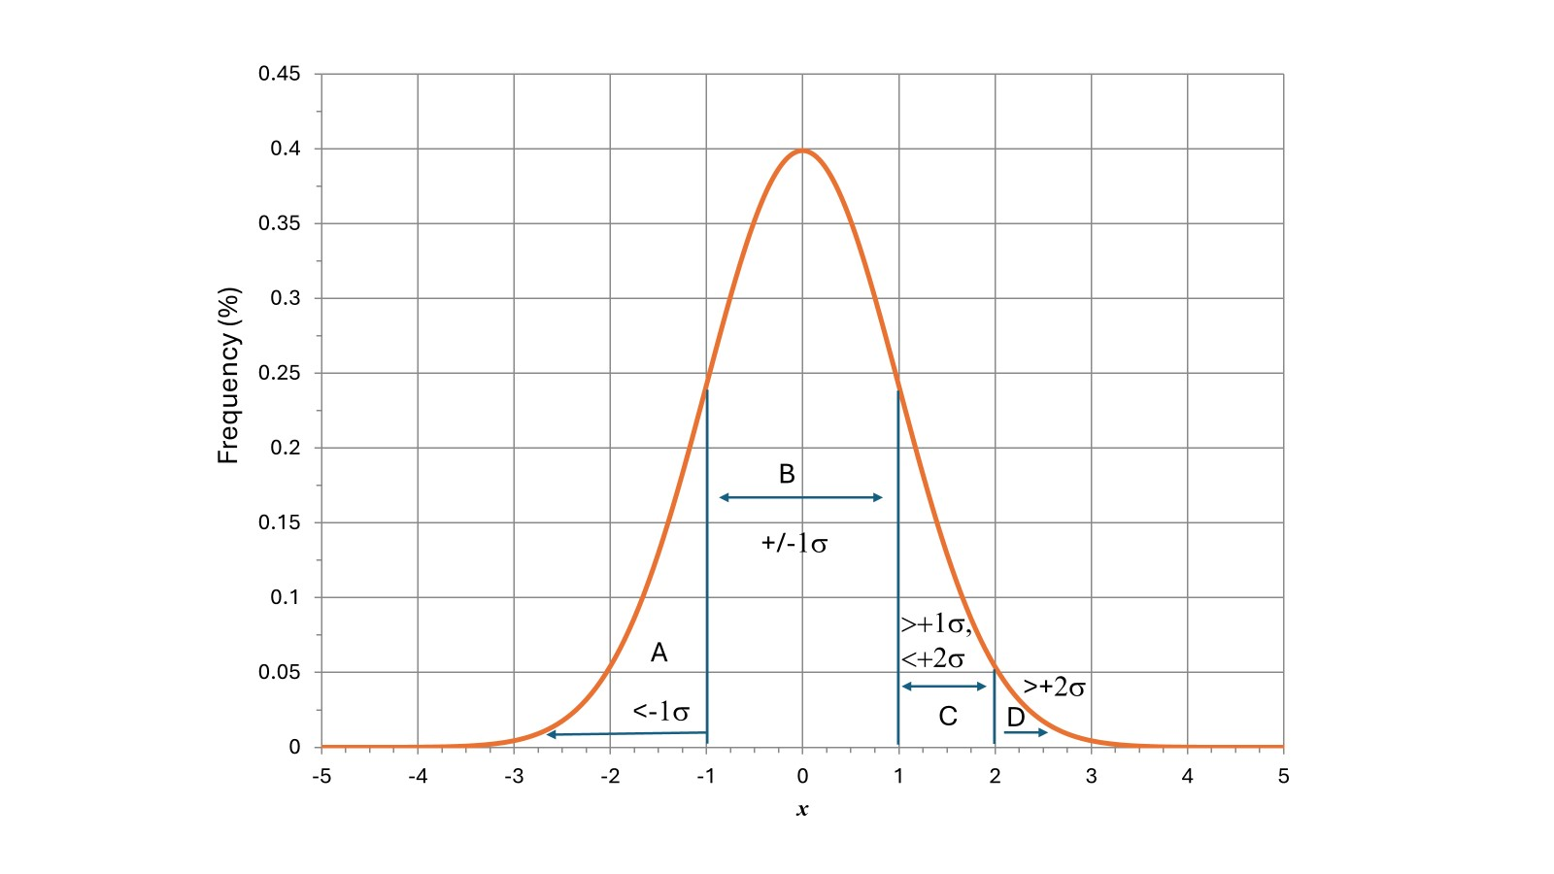
Potential Future State Considerations: Capture Nonlinearities in Deposit Assessment Rates
FDIC’s current scoring approach for large and highly complex banks accounts is linear but the translation from score to rate imposes some nonlinearity of risk factors
However, capturing the degree of nonlinearity might be improved both in terms of transparency and operational ease by using a distributional approach and the matrix approach highlighted in Figure 3.
Scores for specific risk factors could be based on thresholds mapped into deviations away from the mean for peers looking back over time (e.g., net charge offs/total loans > x%)
Figure 3

Slide 11
Potential Future State Considerations: Capturing Risk Amplifiers – adjustments to base assessment rates
  Extranormal growth - Excessive growth can amplify a bank’s riskiness in a number of ways.
    First, a bank’s risk infrastructure may not be able to effectively handle a sharp increase in assets.
    Second, to achieve such growth a bank may rely on expanding its risk appetite as was the case for Washington Mutual when it strayed into nontraditional and subprime mortgage lending prior to 2008.
    Third, fast growth could increase the funding risk at the bank by putting pressure on it to rely more on noncore sources of funding.
    Abnormal growth therefore could amplify both components of bank failure risk; insolvency and run risk.

Slide 12
Potential Future State Considerations: Capturing Risk Amplifiers – adjustments to base assessment rates
  2. Risk Deficiencies - Risk management deficiencies reflect fundamental weaknesses in critical governance, controls and processes used to manage bank risk across the enterprise.
  Bank failures almost always point back to some significant breakdown in risk management and governance
  Risk management is captured in CAMELS which is used as a major rating factor for deposit assessment rates by FDIC across each component and especially the M, for management quality.
  Currently, the weight assigned to CAMELS in all three scorecards is 30 percent.
  CAMELS ratings, however, may not at times be an accurate depiction of a bank’s underlying risk profile or effectiveness of risk management, especially as a bank’s position worsens.
  Alternative measures that may yield more specific insight into a bank’s risk deficiencies include MRAs and MRIAs.

Slide 13
Potential Future State Considerations: Capturing Risk Amplifiers – adjustments to base assessment rates
  3. Capital - The current assessment rate framework accounts for a bank’s Tier 1 leverage ratio.
  Alternatively, a more complete picture of the bank’s capital position is provided by its overall regulatory capital rating which is based on the bank’s leverage and risk-based ratios.
  In the past the leverage ratio has been a binding constraint for many banks as part of the reform to bank regulatory capital following the 2008 financial crisis.
  Replacing or augmenting the leverage ratio then with a bank’s CET1 risk-based capital ratio or other risk-based capital ratios would provide a broader view of a bank’s regulatory capital position for determining assessment rates

Slide 14
Potential Future State Considerations:
Enhancing Consistency and Transparency
In theory, the failure of a small or large bank rests on the same risk drivers, i.e., fundamentals (e.g., market/interest rate, credit, operational risk) and liquidity risk.
Consequently, as enhancements are made to the current risk-based pricing methodology, working to maintain broad consistency in assigning assessment rates across banks is a desirable feature.
At the same time, there are notable differences between small and large banks that may be worth reflecting in the scoring framework.
For example, highly complex banks with trading activities should have market risk factors accounted for in determining their assessment rates that would not be required for small banks.
Moreover, the overall structure of the matrix plus risk amplifiers approach to deposit assessments could still be used by all bank types but with different base assessment rates and factors.
Allowing some adjustments to assessment rates and risk factors based on bank type would be largely consistent with the approach FDIC uses today.

Slide 15
Potential Future State Considerations:
Other adjustments
Other adjustments could be made to base assessment rates including those for unsecured debt and depository debt.
However, the current deposit insurance framework should consider whether to eliminate the unsecured debt adjustment for large banks via further examination of this component in the determination of loss severity.
Moreover, consideration of a systemic risk charge for the largest banks provides a mechanism for connecting the SRE to deposit assessment rates.

Slide 16
Summary and Takeaways
On balance, the current deposit assessment framework enables FDIC to differentiate assessment rates between banks based on certain risk factors, however, significant enhancements could be incorporated going forward.
The current framework lacks a certain cohesion in representing the twin theories of bank failure in determining deposit assessment rates.
Another potential enhancement to the framework would be to recognize the nonlinear impact of risk factors on bank failure.
This is not captured very well in the current deposit assessment rate framework and whether it is failures from 2008, 2023 or another time period, banks that fail are notably different in some aspects of their risk profile from other banks.
Further enhancement of the deposit assessment framework should incorporate risk amplifier adjustments for excessive growth, risk management deficiencies andrisk-based capital.

Slide 17
Summary and Takeaways
Other features of the current scorecard, including loss severity should be retained and possibly enhanced as well, however, greater alignment in the methodology across small, large and highly complex banks should be considered.
Some variation in assessment rates and risk factors could conceivably be accommodated within a more uniform scoring methodology. This would reduce complexity of the methodology.
Leveraging a matrix-based approach augmented with relevant risk amplifier and other adjustments would place the deposit assessment rate methodology on a more solid theoretical foundation, while better differentiating the riskiest institutions from others and becoming more transparent and easier to implement.

Slide 18
References
Correia, Sergio, Stephan Luck and Emil Verner, Failing Banks, Federal Reserve Bank of New York Staff Report, No. 1117, June 2025
Diamond, Douglas W. and Philip H. Dybvig, Bank Runs, Deposit Insurance and Liquidity, Journal of Political Economy, Vol. 91, No. 3, 1983
Morris, Stephen and Hyun Song Shin, Rethinking Multiple Equilibria in Macroeconomic Modeling, NBER Macroeconomics Annual 2000, Volume 15, https://www.nber.org/system/files/chapters/c11056/c11056.pdf

Slide 19
Cliff Rossi Bio
Dr. Rossi is Professor-of-the-Practice, Director of the Smith Enterprise Risk Consortium and Executive-in-Residence at the Robert H. Smith School of Business, University of Maryland. Prior to entering academia, Dr. Rossi had nearly 25 years’ risk management experience in banking and government, having held senior executive roles at several of the largest financial services companies. He is a well-established expert in risk management with particular interests in financial risk management, climate risk, supply chain and health and safety risk issues.
His last industry position was Managing Director and Chief Risk Officer for Citigroup’s Consumer Lending Group where he was responsible for overseeing the risk of a $300+B global portfolio of mortgage, home equity, student loans and auto loans with 700 employees under his direction. While there he was intimately involved in Citi’s TARP and stress test activities. He also served as Chief Credit Officer at Washington Mutual (WaMu), Managing Director and Chief Risk Officer at Countrywide Bank and Chief Economist and Chief Analytics Officer at Radian Guaranty.
Before these assignments, Dr. Rossi held senior risk management positions at Freddie Mac and Fannie Mae. He was co-inventor of 3 patents on credit risk derivative instruments while at Freddie Mac. He started his career during the thrift crisis at the U.S. Treasury’s Office of Domestic Finance and later at the Office of Thrift Supervision working on key policy issues affecting depositories. Dr. Rossi was also an adjunct professor in the Finance Department at the Robert H. Smith School of Business for eight years and has numerous academic and nonacademic articles on banking industry topics. Dr. Rossi is frequently quoted on financial policy issues in major newspapers and has appeared on such programs as Fox News, Canada’s BNN, C-SPAN’s Washington Journal and CNN’s Situation Room.
His practitioner-oriented and graduate textbook, A Risk Professional’s Survival Guide: Applied Best Practices in Risk Management for John Wiley & Sons, Inc. was released Fall 2014. He also authored a weekly column, Risk Doctor in the American Banker and in HousingWire on risk and regulatory reform issues and CRO Outlook for the Global Association of Risk Professionals. He has testified before Congress on a number of financial policy and climate risk issues. Dr. Rossi serves as an advisor to banks, federal regulatory agencies, private equity investment companies and hedge funds on banking and regulatory topics and founded Chesapeake Risk Advisors, LLC a financial risk management consulting practice in 2009. He received his PhD from Cornell University in financial economics and quantitative methods.

