Slide 1
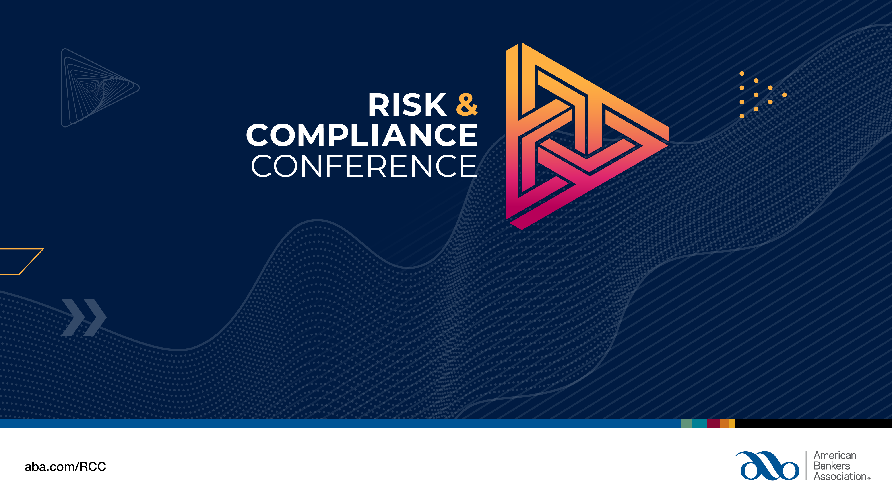
Session name

Slide 2
General Session
Wednesday June 14, 2023, 4:00-5:00PM

Slide 3
Strengthening Your Risk Culture in Volatile Times
Clifford Rossi, PhD
Director, Smith Enterprise Risk Consortium
Professor-of-the-Practice
Executive-in-Residence
Robert H. Smith School of Business, University of Maryland

Slide 4
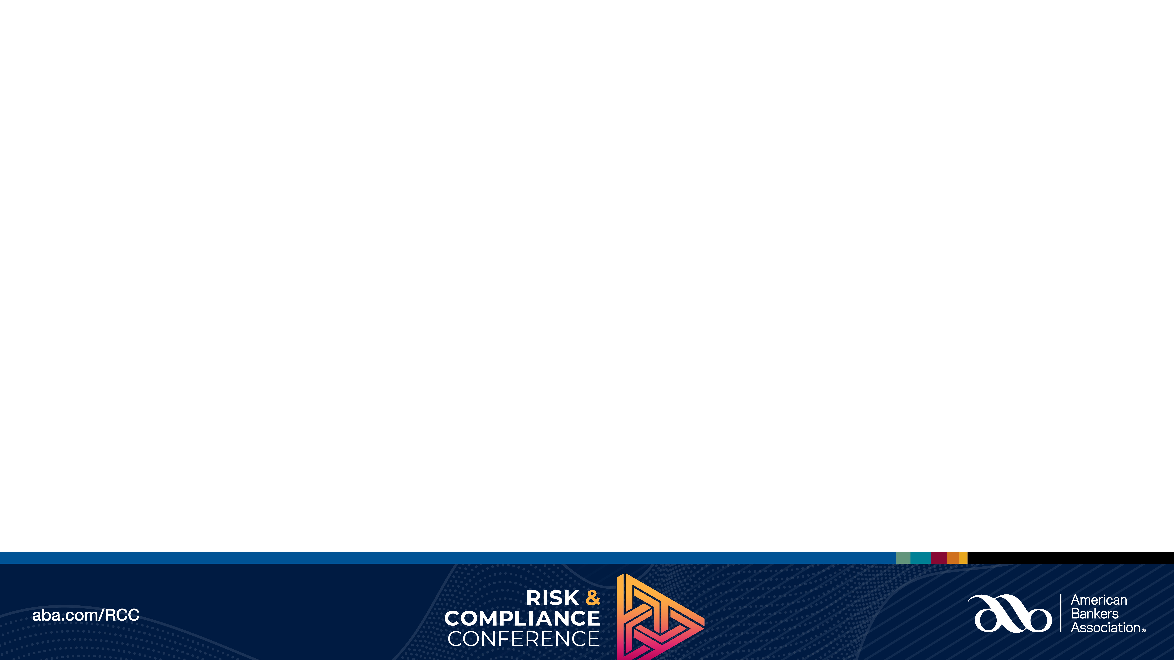
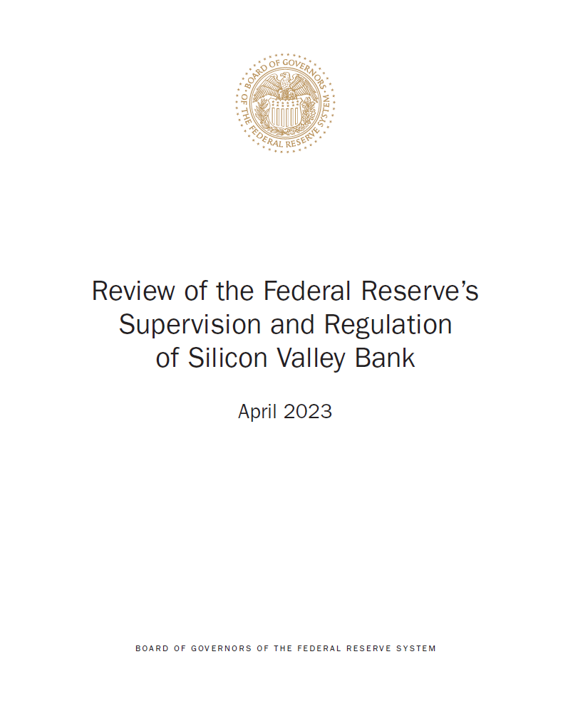
Risk Culture in the Headlines
Recent spate of bank failures highlight importance of risk culture
  Reinforced by Federal Reserve report on Silicon Valley Bank
  Drivers of Failure
    Poor interest rate and liquidity risk management burned SVB
    Poor risk culture lit the match
But this recent banking turmoil is just reflection of a recurring theme of episodic risk events whether it’s the 1980s, 2008, or 2023.
What is the common link to all these events?

Slide 5

What Exactly is Risk Culture?
Culture – the set of shared attitudes, values, goals, and practices that characterizes an institution or organization
  Merriam Webster Dictionary
Risk culture is the firm’s DNA
The “glue” that binds its risk appetite with business strategy and organizational execution of that strategy

Slide 6

How Does Risk Culture Manifest?
Executive Management sets the cultural expectations
Management teams reinforce those expectations with employees
Employees disseminate that culture across organizations and lines of defense
Boards ensure risk culture is nourished – how?
  Executive sessions with CRO
  Credible challenge of management
  CRO reporting line to board risk committee

Slide 7

What Internal Factors Detract from Risk Culture?
Senior management cognitive biases
Aggressive or passive aggressive behavior
“Us-Them” mentality
Boards lacking credible challenge to management
Domineering CEO with strong company performance track record
Risk management units that do not understand business needs, lack confidence and courage of their convictions

Slide 8

What External Factors Detract from Risk Culture?
Focus on short-term earnings leads to risk myopia
  Amplifies any imbalance between risk and reward
Asymmetric information about competition’s products and performance can undermine risk culture and practices

Slide 9

Symptoms of Poor Risk Culture
Abnormal turnover in risk management personnel
Limited access of CRO to the Board
Lack of balance in risk and return
Low morale among risk professionals
Risk management not engaged in strategy or critical business decisions
Strategic and incentive compensation plans lacking risk objectives
Lack of stature and credibility of the risk organization
Return
Risk

Slide 10
Key Roles in Fostering Risk Culture
Board actively engaged in understanding risks
CEO embraces and articulates desire for strong risk culture
Executive Committee reinforces CEO message
Risk management projects balance, credibility and partnership across the enterprise

Slide 11
Ingredients for Cultivating Risk Culture
Communication
Transparency
Objectivity
Risk Culture
Incentive Alignment
Risk
Awareness
Temperament
Balance

Slide 12

Be A Change Agent for Risk Culture
Risk culture can’t be imposed by regulation it must come from within
However, regulators could help by reworking the M in CAMELS
The currency to achieving a thriving risk culture is value to the enterprise
Balance, effective counsel and domain expertise on business and risk issues by risk organizations is essential

Slide 13
Tactical Steps for Cultivating Risk Culture
Take the pulse of the organization to establish a baseline with a risk culture survey with annual updates
Initiate job rotations between 1st, 2nd and 3rd lines of defense
Establish quarterly business and risk townhall updates hosted by senior business, finance and risk leaders
Hone risk management and business expertise among staff

Slide 14
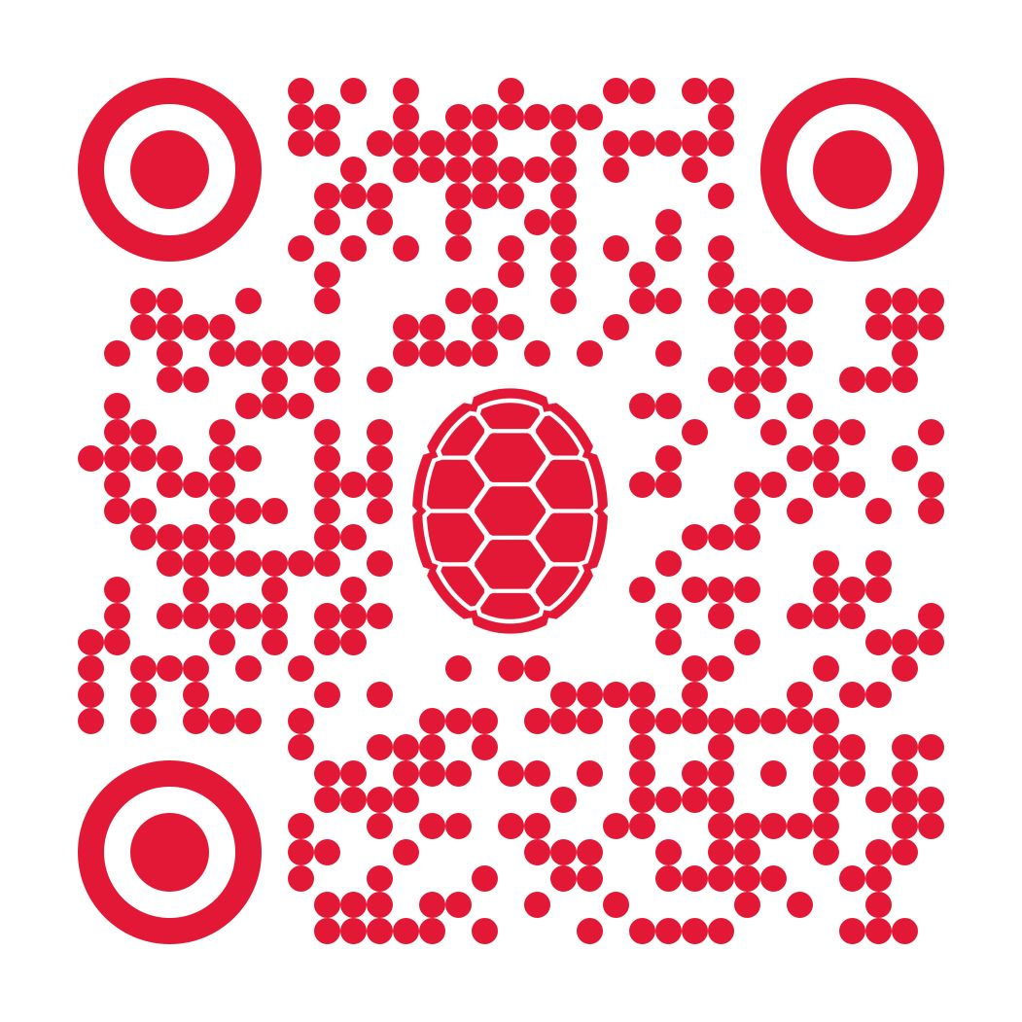
Takeaways
A company’s risk DNA is central to its long-term success
You can’t turn a switch on building risk culture, and it can’t be imposed on an organization through regulation
Effective risk culture is a two-way street:
  Senior management and boards must acknowledge its importance
  However, stature and respect of the risk organization on which a strong culture is built must be earned
Contact Information for Dr. Rossi:
  crossi@umd.edu

